Slide 1
Effective communication and communication skills
22.2 Batch

Slide 2

Why is communication important?
Important for expressing information, behaviour and our feelings and thoughts.
Helps to understand and respond to other’s feelings, thoughts, knowledge and behaviour.

Slide 3
Verbal communication
Verbal Communication
Written
Oral
Reports
Face to face conversation
Telephone conversations
Memos
Meetings
Emails
Group discussions
Illustrations

Slide 4
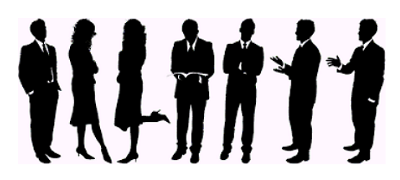
Non-verbal communication
Descriptive of the underlying components of communication that are also transmitted with the verbal components.

Slide 5
Non-verbal Communication
Paralanguage
Kinesics
Accent
Emphasis
Gestures
Posture
Speed
Intonation
Proxemics
Facial expressions
Eye contact
Haptics

Slide 6
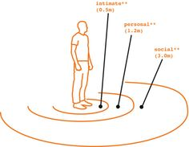
proxemics
The requirement of personal space and the degree of separation that individuals maintain between each other in social situations.

Slide 7
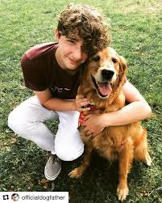
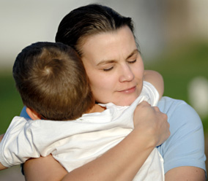
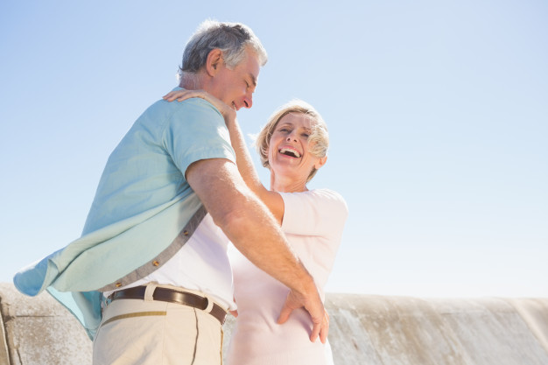
intimate

Slide 8


Personal

Slide 9

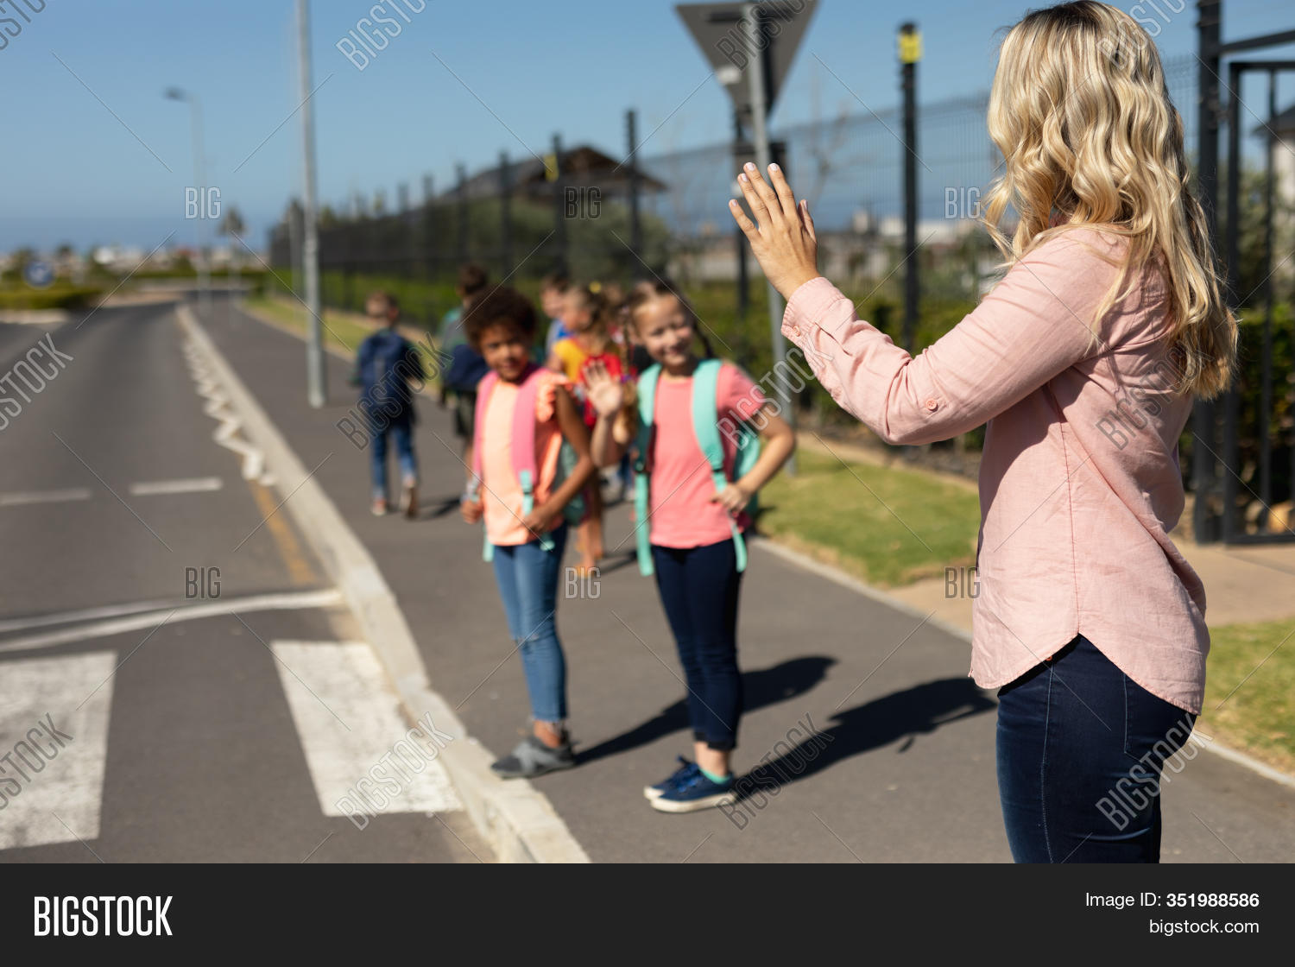
social

Slide 10
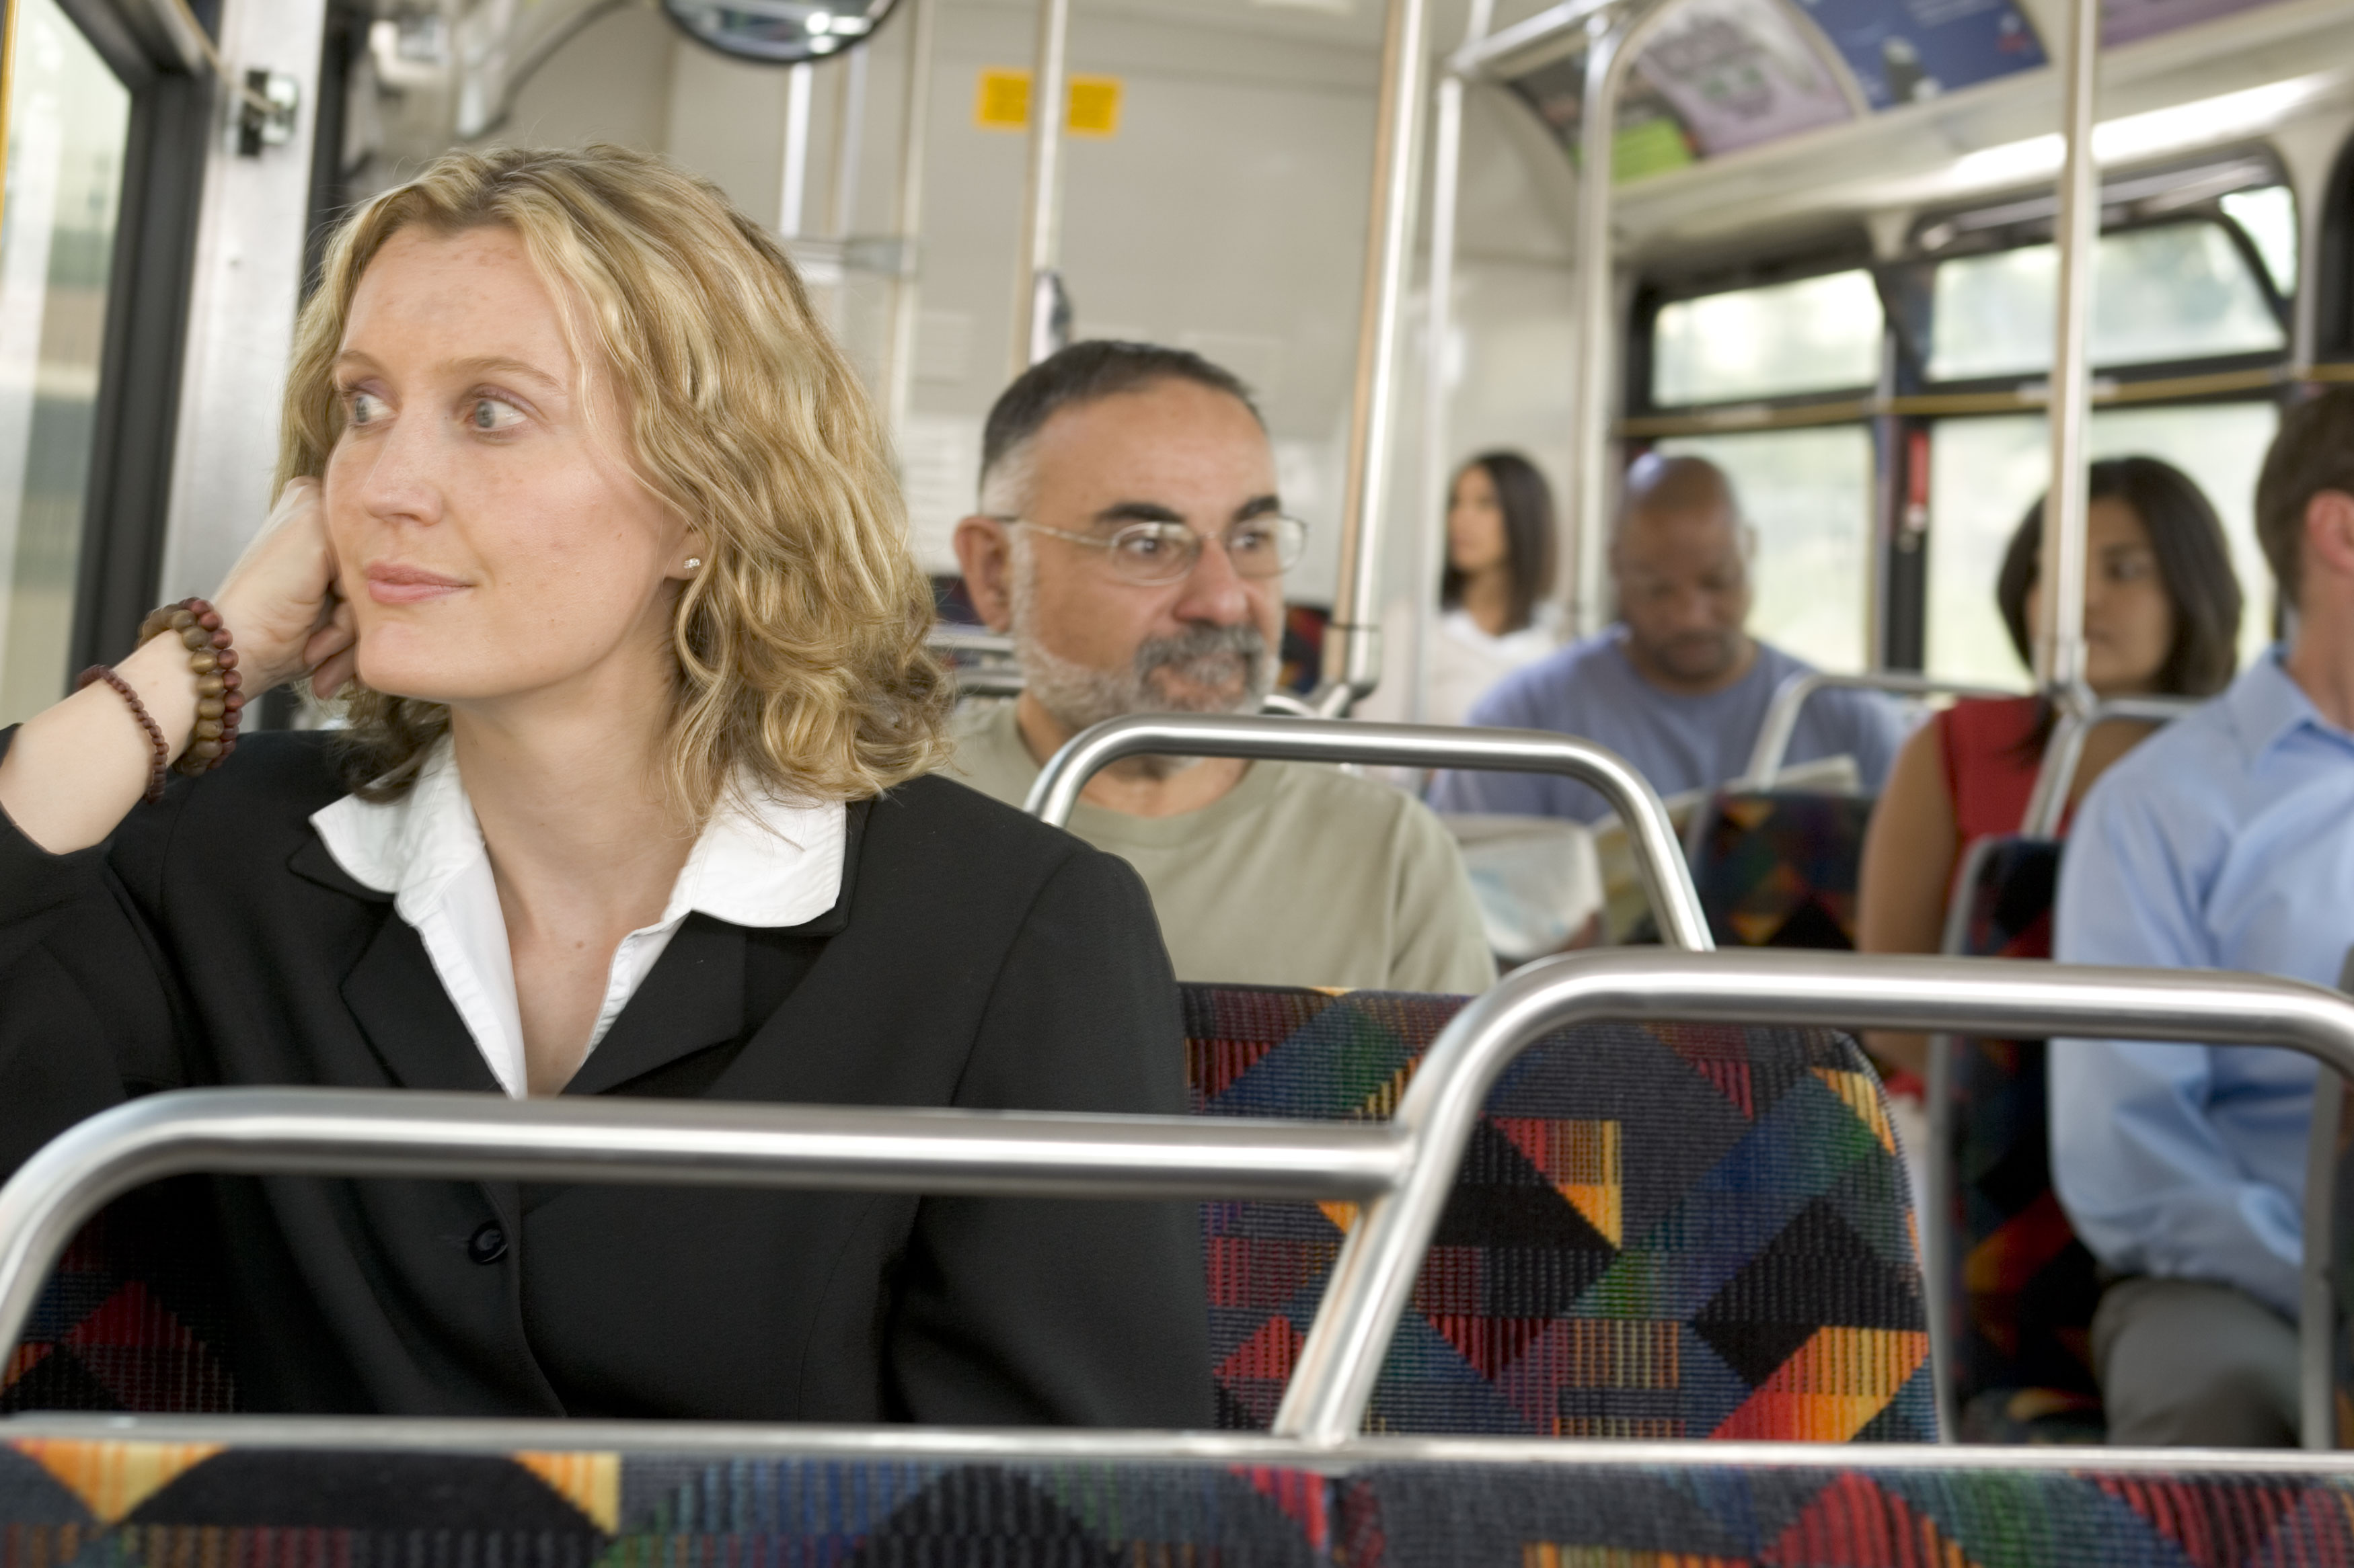
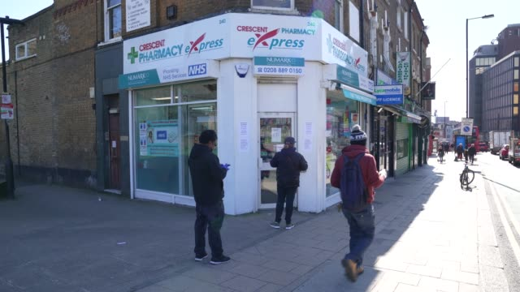
public

Slide 11
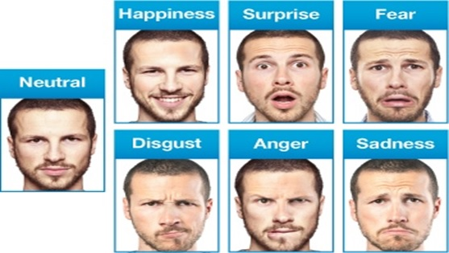
Facial expressions
The human face is extremely expressive and unlike some forms of nonverbal communication, facial expressions are universal. The facial expressions for happiness, sadness, anger, surprise, fear, and disgust are the same across cultures.

Slide 12

Eye contact
A form of communication and is thought to have a large influence on social behaviour.

Slide 13
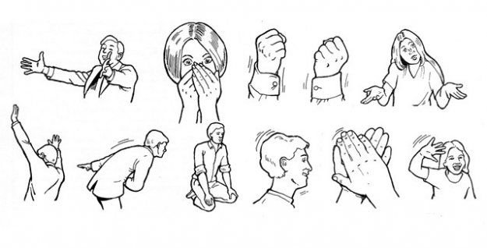
Gesture
A movement of part of the body, especially a hand or the head, to express an idea or meaning

Slide 14

Posture
The position or bearing of the body whether characteristic or assumed for a special purpose which may indicate personality traits such as confidence, submissiveness, and openness.

Slide 15
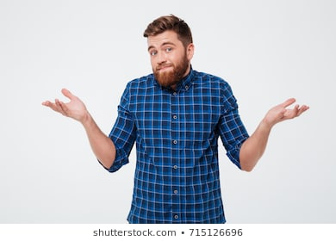
Shoulder shrug

Slide 16
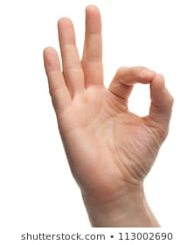
The ‘ring’

Slide 17


Folded hands

Slide 18
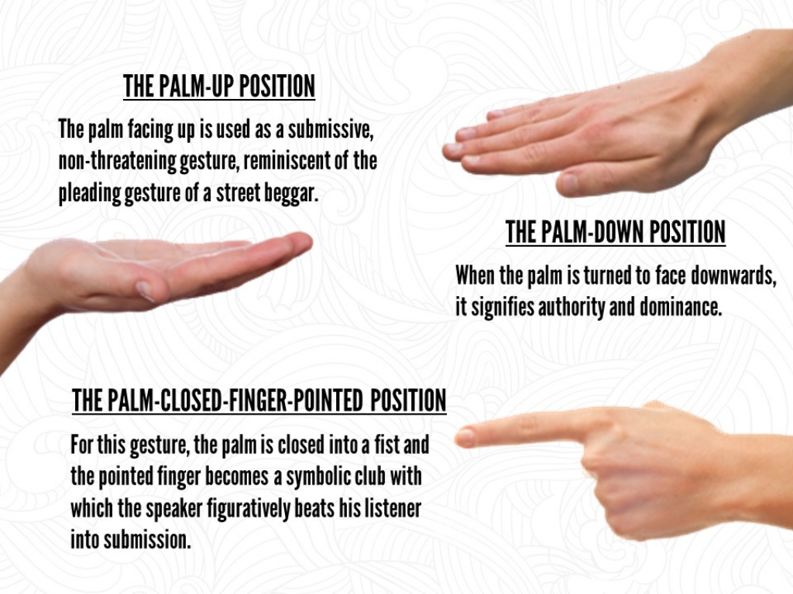
Palm positions

Slide 19

Rubbing hands

Slide 20
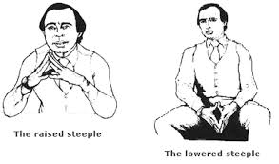
Hands steeple

Slide 21
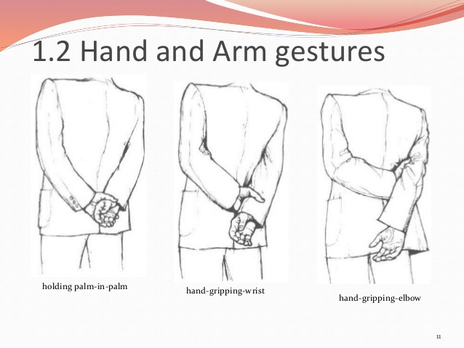
Gripping hands

Slide 22
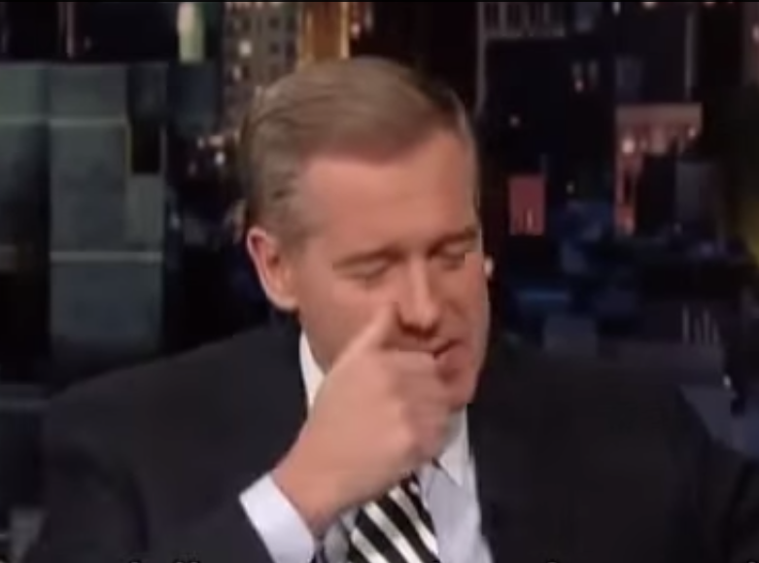
Touching the nose

Slide 23
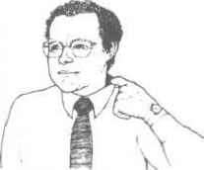
Collar pull

Slide 24
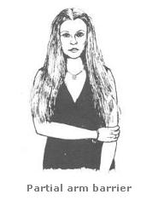
Partial arm cross barrier

Slide 25
activity
Identify 5 different gestures that have contradictory meanings in different cultures.

Slide 26

haptics
Refers to the ways in which people communicate and interact via the sense of touch.

Slide 27
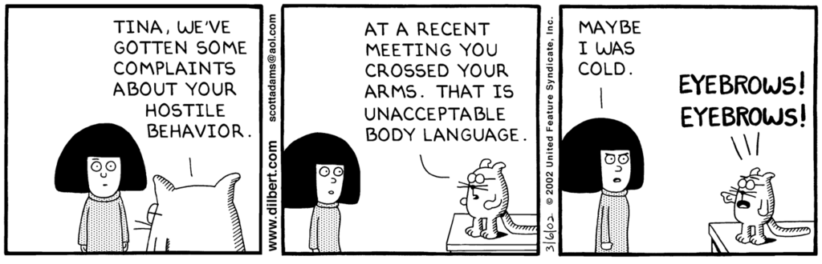
paralanguage
May modify meaning, give nuanced meaning, or convey emotion, by using techniques such as accent, speed, pitch, intonation,

Slide 28
Barriers to communication
Attitudinal
Behavioural
Communication Barriers
Cultural
Language
Environmental

Slide 29

Tips to overcome the barriers
Know your audience
Listen actively
Be open-minded
Use a positive tone

Slide 30
Thank you!

